Slide 1
بسم الله الرحمن الرحیم

Slide 2
Role of EUS in diagnosis and treatment of Acalagasia

Slide 3
The EUS is actually not a regular procedure for the diagnosis of achalasia. The EUS was firstly used in achalasia patients in 1989 by Deviere et al., in their study the thickness of the muscle layer of lower esophageal sphincter (LES) was measured

Slide 4
t was reported that the achalasia patients had much thicker LES than control group (6). However, this has been questioned by other investigators due to various results obtained from the application of EUS in the measurement of muscular layer thickness in achalasia patients (7)..

Slide 5
. With the development of high frequency EUS probe, the identification of inner and outer muscular layer in the EGJ is feasible, thus make it possible to establish the difference of the muscular layer in the EGJ between the achalasia patients and healthy population. It was reposted by Barthet et al. that the fourth hypoechoic layer of the cardia wall was thicker in achalasia patients. However, the difference between them was very slight thus the EUS might not be a helpful tool to diagnose achalasia (8).

Slide 6
The other role of EUS in achalasia is to rule out pseudo-achalasia. The mass originated from the muscular layer of or outside EGJ could be detected by EUS. The inflammation in the muscular layer could also be detected. EUS has also been used to guide the therapy of achalasia including the Botox injection and the intra-operation evaluation during POEM.

Slide 7
Endoscopic ultrasound — Findings of achalasia on endoscopic ultrasound (EUS) can include a thickened circular muscle layer at the LES and through the smooth muscle esophagus. Although the accuracy of EUS in distinguishing achalasia from pseudoachalasia has not been established, EUS is useful for characterizing tumors of the distal esophagus and gastric cardia

Slide 8
EUS findings of marked (>10 mm) and/or asymmetric esophageal wall thickening are suggestive of an underlying malignancy that may be confirmed by fine-needle aspiration. (

Slide 9
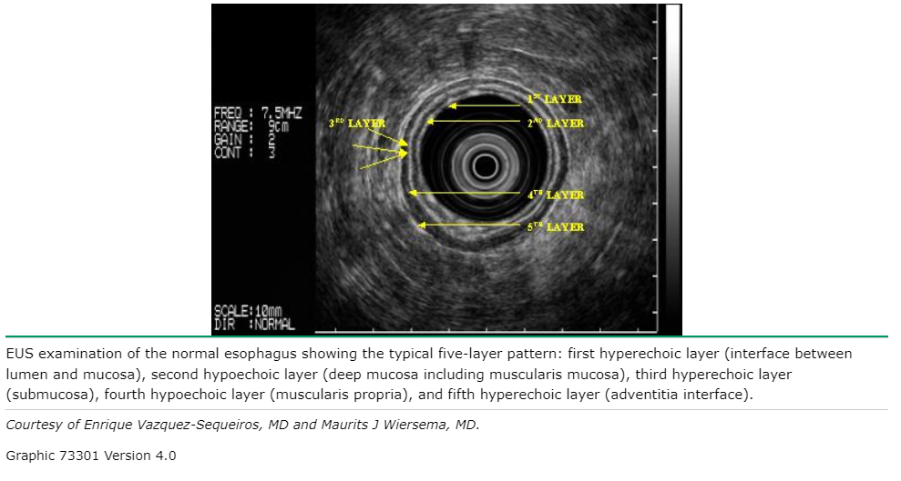

Slide 11
●First and second layer: superficial mucosa (hyper and hypoechoic respectively).
●Third layer: lamina propria (hyperechoic).
●Fourth layer: muscularis mucosa (hypoechoic).
●Fifth layer: submucosa (hyperechoic).
●Sixth, seventh, and eighth layer: (hypo, hyper, and hypoechoic respectively) inner circular muscle and outer longitudinal muscle of the muscularis propria with intermuscular connective tissue.
●Ninth layer: adventitia (hyperechoic)

Slide 12
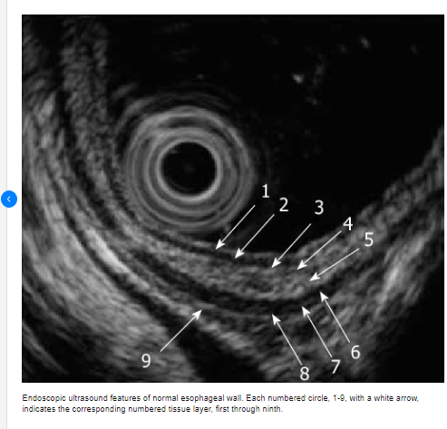

Slide 13
The muscularis propria is divided in two layer the outer longitudinal and the inner circular muscle wall layer seprated by a connective tissue inetrface

Slide 14
The normal thickness of the circular layer 0.3 -1mm
In the patient with achalasia the thickness of circular wall layer can be vary from 1.5 to 6mm

Slide 15
HYDATIC CYST

Slide 16
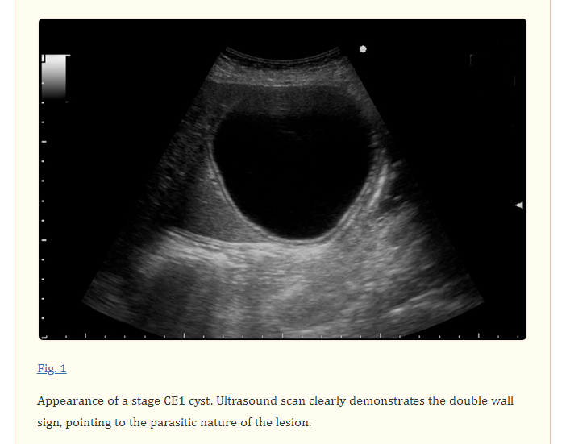

Slide 17
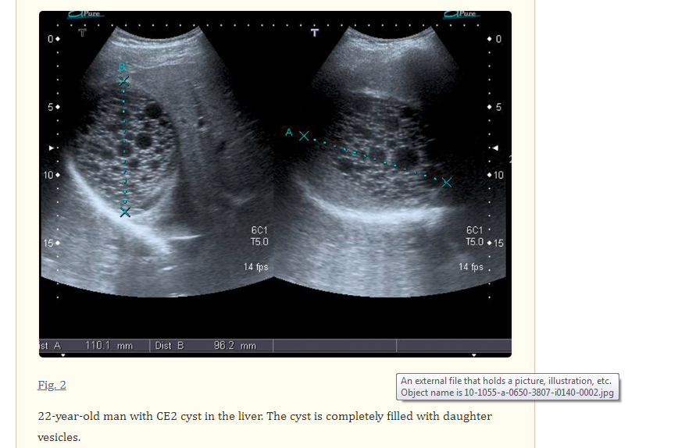

Slide 18
The CE2 cyst is completely filled with daughter vesicles. What appears as “septa” are not true septa but the cyst walls of the daughter vesicles adjacent to one another

Slide 19
CE3 cysts includes two stages, CE3a and CE3b, which differ in terms of morphology, viability and clinical characteristics. CE3a is characterized by the “water-lily” sign, represented by floating membranes, i. e. the endocyst detached from the cyst outer wall (pericyst) Fig. 3 . CE3b is a predominantly solid lesion with daughter vesicles Fig. 4 and Fig. 5 . CE3a may go on to become “solid” (inactive) or may give rise to daughter vesicles, in which case it becomes a CE2 cyst

Slide 20
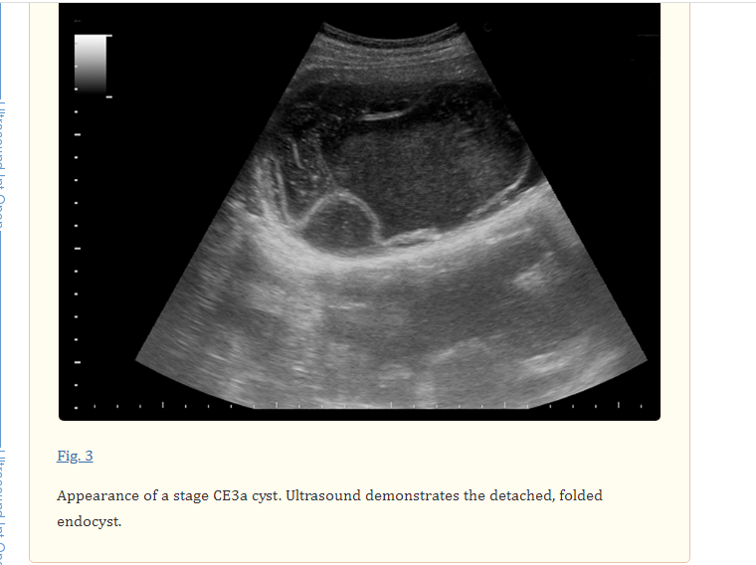

Slide 21
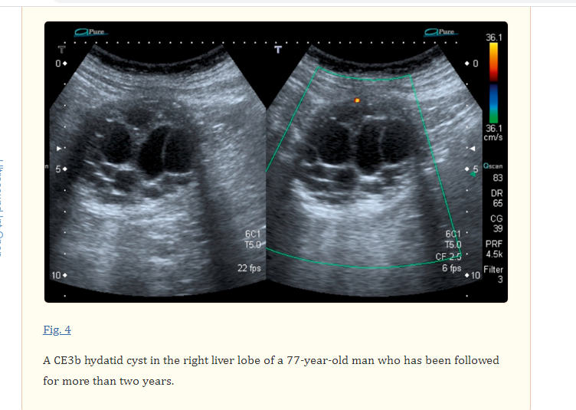

Slide 22
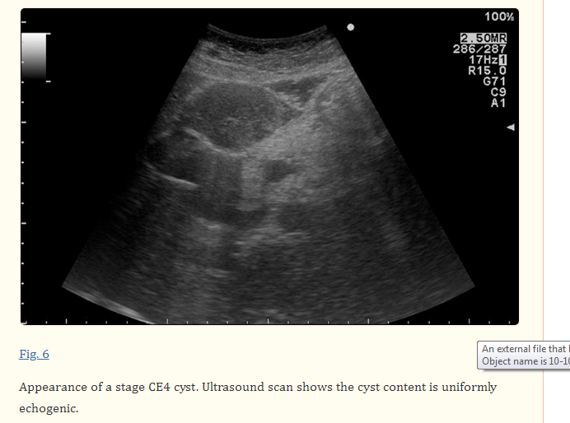

Slide 23
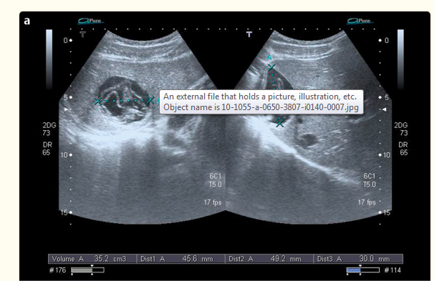

Slide 24
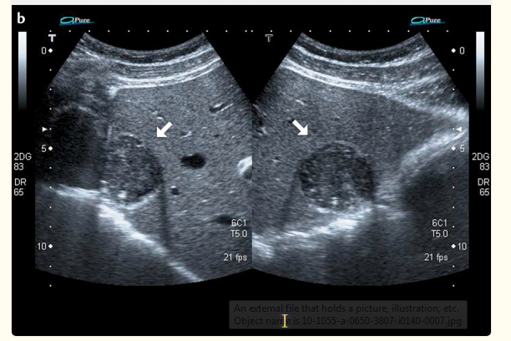

Slide 25
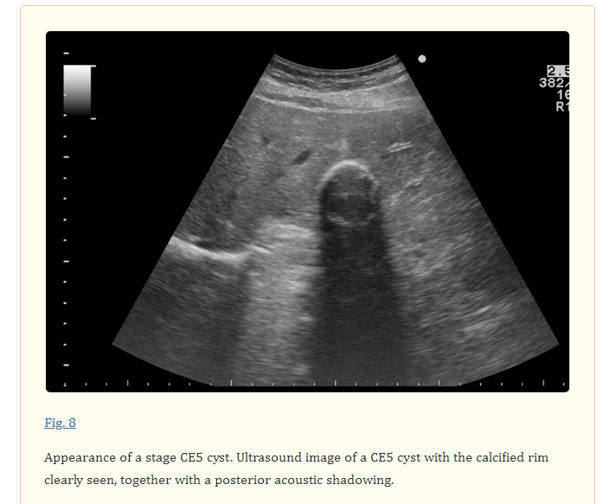

Slide 26
A 69-year-old female with unremarkable past history underwent an upper endoscopy for dyspepsia. She denied weight loss, anorexia, asthenia, or vomits. Physical examination was normal. Upper endoscopy revealed a bulge in the lesser curvature and the posterior wall of the stomach with 4-5 cm (Figure 1). Endoscopic ultrasound (EUS) was performed and showed a heterogeneous lesion, mainly anechogenic one, with a floating membrane inside, and greatest diameter of 90.8 × 17.2 mm, originated in the liver left lobe (Figure 2). The diagnosis of a hydatid cyst type 3 was made. A surgical resection was performed. The patient recovered without complications

Slide 27
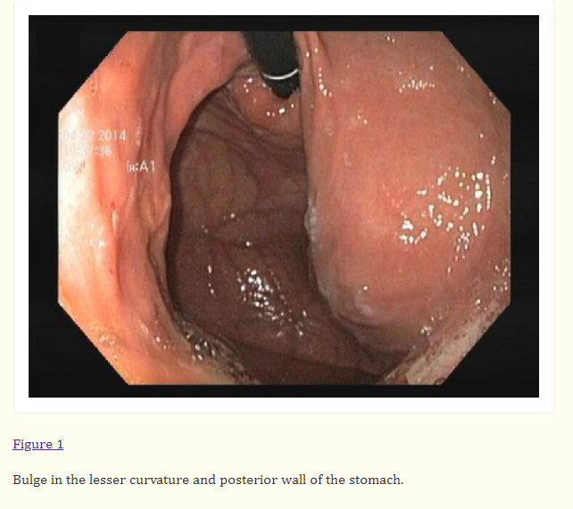

Slide 28
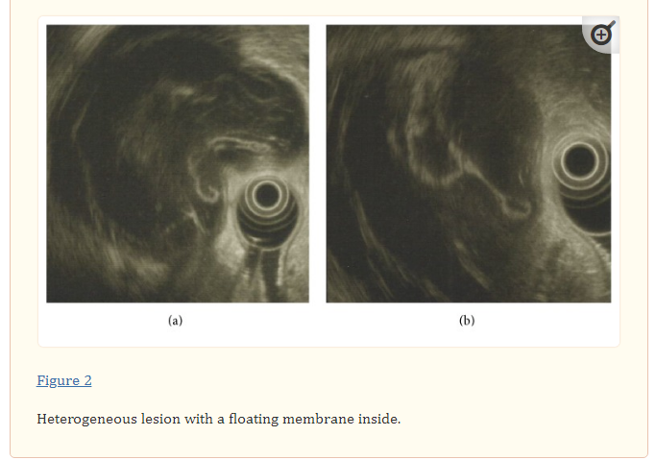

Slide 29
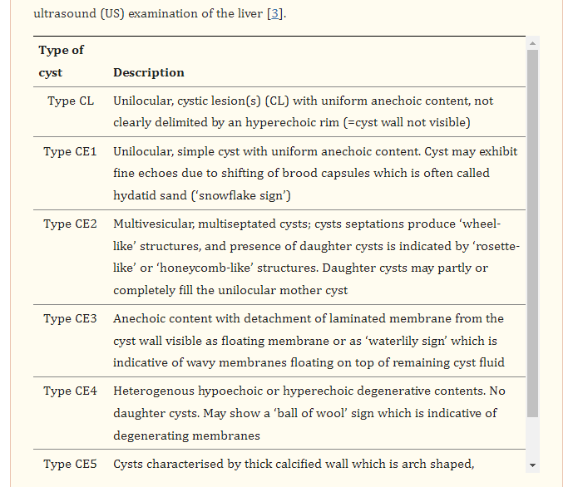

Slide 30
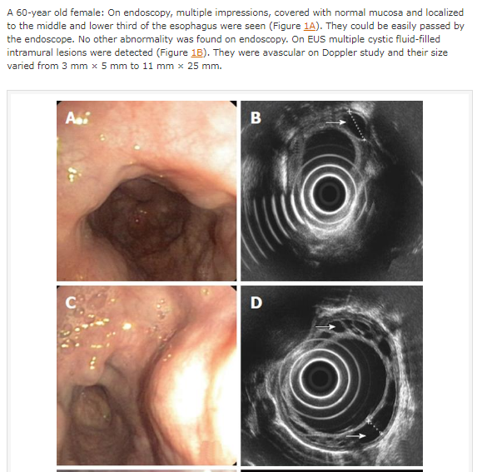

Slide 31
از حسن توجهتان سپاسگزارم

