Slide 1

بررسی فراوانی و تعیین تایپ ویروس‌های عامل عفونت تنفسی آدنوویروس، پاراانفولانزا ویروس، بوکاویروس و متاپنوموویروس با روش مولکولی در نمونه بیماران دارای علائم تنفسی
گردآورنده
ریحانه ساده طهرانی

Slide 2
Table of Content
1
5
Introduction
Conclusion
۸-۵
۸-۵
2
6
Method
Proposition
۸-۱۲
۸-۵
3
Results
7
Appreciation
۸-۵
۸-۵
4
Discussion
8
Article
۸-۵
۸-۵

Slide 3
RTI
Your Subtitle Here
2
4
STEP 01
STEP 01
Refers to a good or service
Refers to a good or service
1
3
5
STEP 01
STEP 01
STEP 01
Refers to a good or service
Refers to a good or service
Refers to a good or service

Slide 4

Bocavirus
Adenovirus
PROVIDING THE BEST SOLUTIONS
Refers to a good or service being offered by a company. Ideally, a product should meet a certain consumer demand, or it should be so compelling that consumers believe they need it.

Slide 5
Corona
Virus
Human
metapneumovirus
PROVIDING THE BEST SOLUTIONS
Refers to a good or service being offered by a company. Ideally, a product should meet a certain consumer demand, or it should be so compelling that consumers believe they need it.

Slide 6
Human
Parainfluenza
Viruses
Respiratory
Syncytial
virus
PROVIDING THE BEST SOLUTIONS
Refers to a good or service being offered by a company. Ideally, a product should meet a certain consumer demand, or it should be so compelling that consumers believe they need it.

Slide 7
Prevalence of Respiratory viruses in Iran
Human Bocavirus
7 Percent
Human Metapneumovirus
8.9 Percent
Respiratory Syncytial Virus
18.7 Percent
Human Parainfluenza viruses
10.51 Percent >

Slide 8
Aims of the study
IMPROVE
Refers to a good or service being offered by a company ideally a product
REBRAND
Refers to a good or service being offered by a company ideally a product
SUCCESS
Refers to a good or service being offered by a company ideally a product
SUCCESS
Refers to a good or service being offered by a company ideally a product

Slide 9
Method of the Study
By HiTeq 17 Viro Respiratory pathogen One Step RT-PCR Kit
Since March 2021
To July 2022
Sample collection
Genome Extraction
Realtime PCR
Analysis
BehGene kit
SPSS
Ki Score
Anova

Slide 10
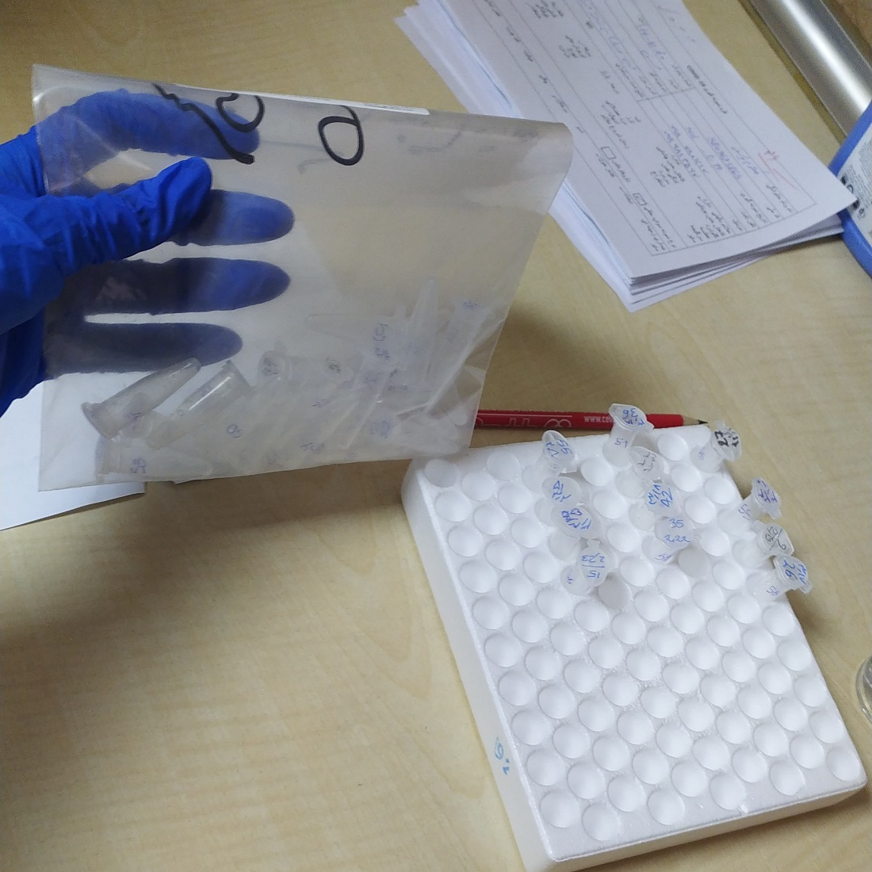
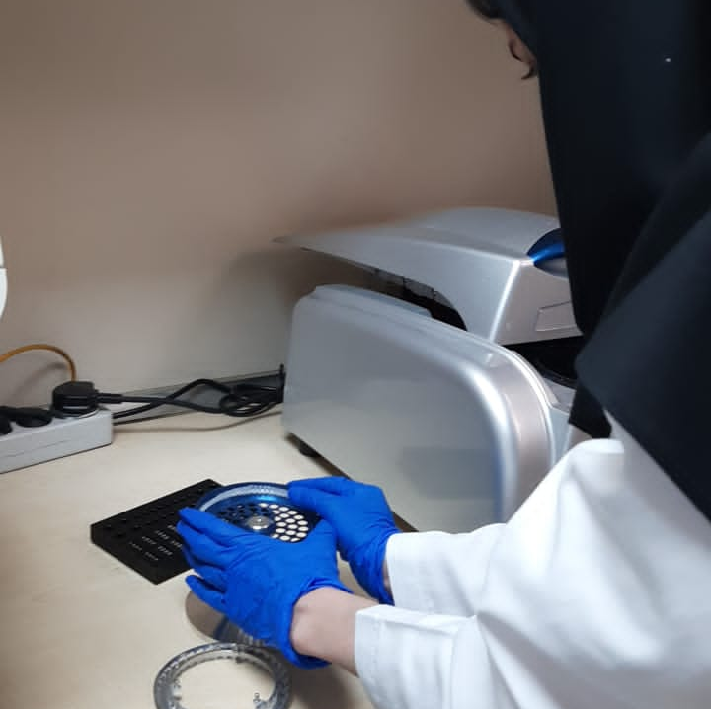
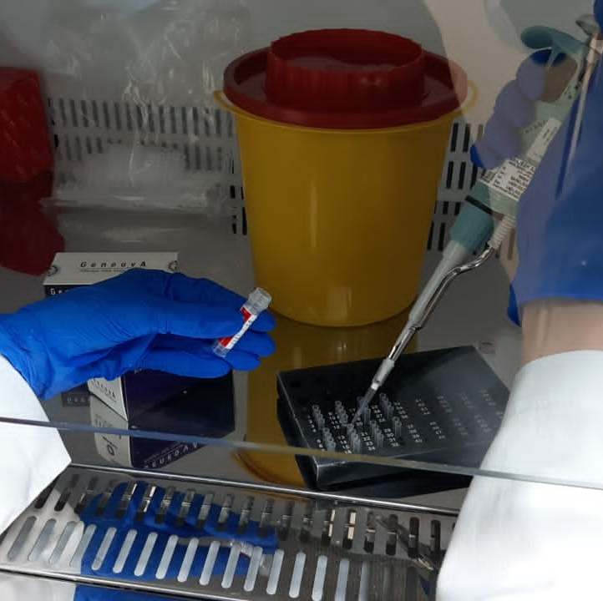
From Extraction
To PCR

