Slide 1
Application Identification Info
Electronic Application No.
Proposal Title | Effects of radiotherapy on Cancer-Associated Fibroblasts in locally-advanced rectal cancer patients
Name of Principle Investigator (PI) | Dr. Ali Mohammad Alizadeh
Primary University/Institution/Center | Tehran University of Medical Sciences/Cancer Institute
Secondary University/Institution/Center | Lille University/Cell Biology Department
Tertiary University/Institution/Center | Iran University of Medical Sciences
The planned duration of the project | 36 months
Keywords | Radiotherapy, Cancer-Associated Fibroblast, Rectal cancer

Slide 2
Cancer-Associated Fibroblasts
(CAFs)

Slide 3
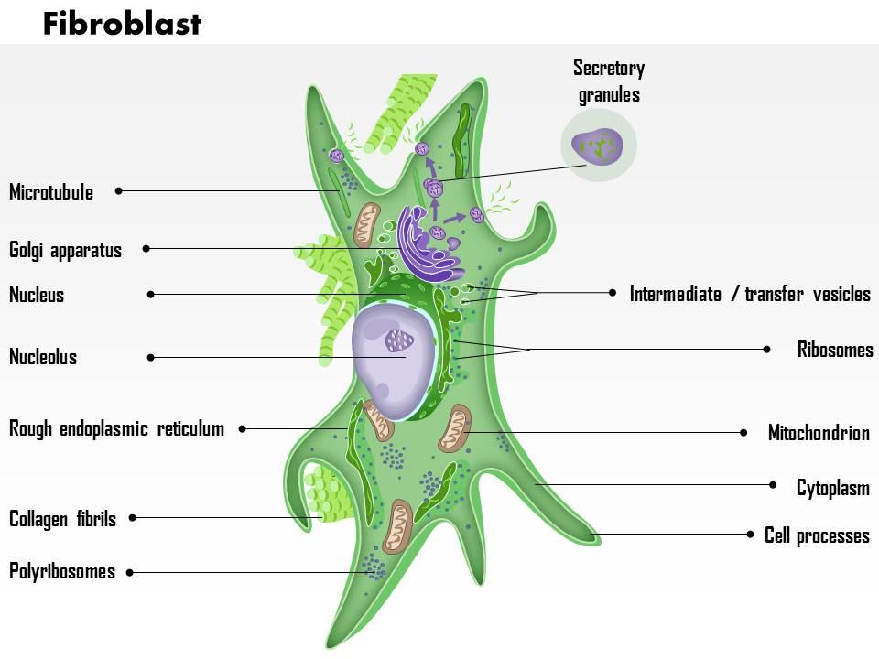

Slide 4
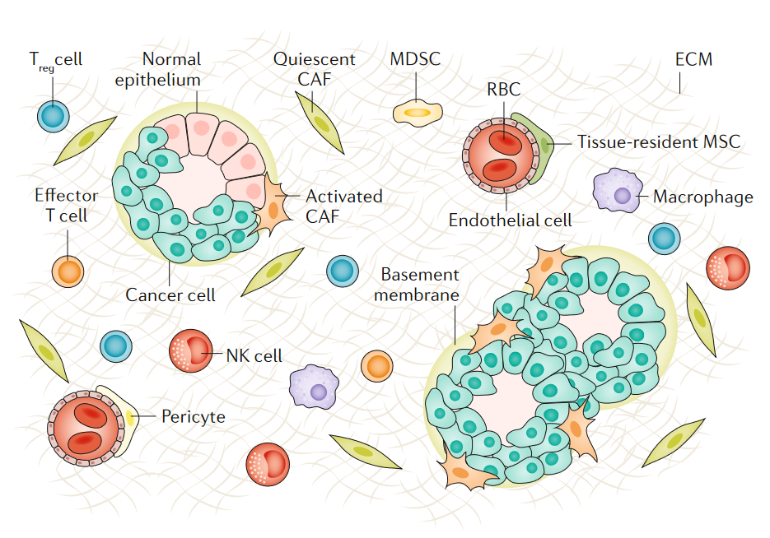

Slide 5
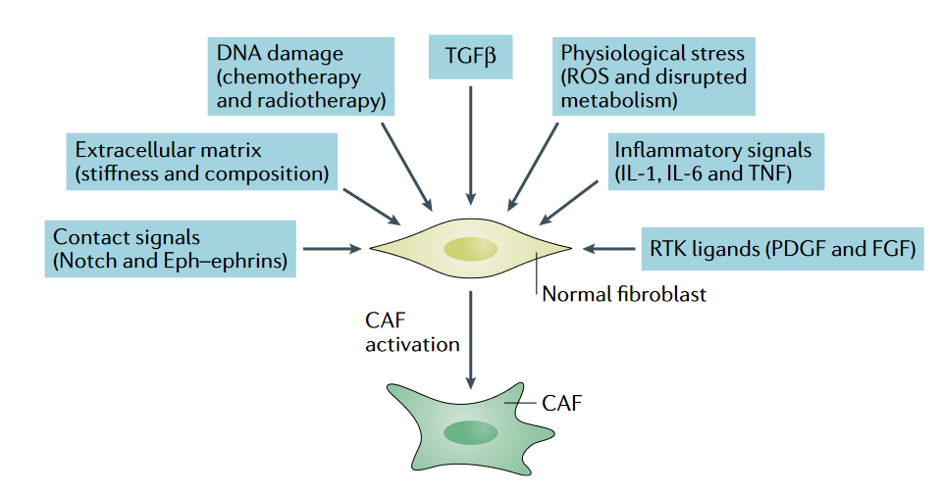

Slide 7
Radiotherapy
&
CAFs

Slide 8
Enrolment
125 patients
Inclusion criteria: -Age 30 ̶ 70 years -Locally-advanced rectal cancer - Stage II/III -No history of cancer
Exclusion criteria:
-History cancers
-Autoimmune diseases
-Serious kidney and liver problems
-Recurrent cancer
- RT contraindication
Blood sampling
Tumor sampling
CRF
0
Radiation (30 sessions)
Blood sampling
Tumor sampling
CRF
Pre-Operation
13th week
Follow: Times (month)
Follow up: 6, 12, 18, 24
CRF
IHC: FAP, α-SMA, FSP-1, PDGFR-β
ELISA: Cytokine array
Statistical analyses
Assays
CAF isolation/ Microarray assay
RT-PCR: To confirm Microarray results

Slide 9
Specific objectives
1- Determining CAF markers, α-SMA, FSP-1, FAP, and PDGFR-β, pre-and post-radiotherapy in patients with locally-advanced rectal cancer
2- Determining the serum levels of CAF-specific cytokines pre-and post-radiotherapy in patients with locally-advanced rectal cancer
3- Comparison of critical genes and pathways of CAFs by Microarray analysis in patients with locally-advanced rectal cancer pre-and post-radiotherapy
4- Determining levels of CAFs in locally-advanced rectal cancer patients who responded to treatment compared to treatment-resistant patients
5- Determining the correlation of para-clinical parameters, including age, gender, tumor size, metastasis, recurrence, and 2-year survival with levels of CAFs in patients with locally-advanced rectal cancer

Slide 10
Effects of Lactobasilous acidophil probiotics on Hepatocyte growth factor (HGF) in locally-advanced rectal cancer patients

Slide 11
HGF
CAFs
VEGF
TGF-β
RAF
RAS
EGF
c-MET
MAPK
Her2
GAB1
SRC
PI3K
HGF
AKT
GRB2
IKK
Rho
STAT3
NFKB
ROCK
IL-6
STAT3
JAK
PI3K
RAS
HGF,
VEGF, TGFB
RAF
RAS
ERK
FGF
CRK
CDC42
AKT
RAF
RAC1
FAK
MAPK
PAK
mTOR
JNK
NFKB
JNK
TWIST
Snail/slug
ERK
Proliferation, Invasion, Migration, Angiogenesis, Survival, Anti-apoptosis, Pro-inflammatory, Tubulogenesis, EMT, Growths,
Up-regulated mesenchymal
genes e.g. Vimentin
Cancer Cells

